Slide 1
19CSE305 - MACHINE LEARNING
DISEASE PREDICTION FROM SYMPTOMS
TEAM MEMBERS
KRISHNA MURTHY - CB.EN.U4CSE21016
S MEENAKSHI - CB.EN.U4CSE21035
LIKITHA PICHERI - CB.EN.U4CSE21044
RAGALA TEJDEEP - CB.EN.U4CSE21046

Slide 2
Disease Prediction from Symptoms
Introduction:
People are currently suffering from a variety of diseases.
Many people are unsure if the symptoms they are experiencing are indicative of a certain disease, and hence they are unable to take the required safeguards.
Disease prediction of a human means predicting the probability of a patient’s disease after examining the combinations of the patient’s symptoms.
Motivation/ significance:
The major goal of this project is to greatly aid physicians in predicting and diagnosing diseases at an early stage, as well as to design a model that will assist people in identifying diseases at an early stage so that risk may be decreased
This analysis in the medical industry would lead to a streamlined and expedited treatment of patients

Slide 3
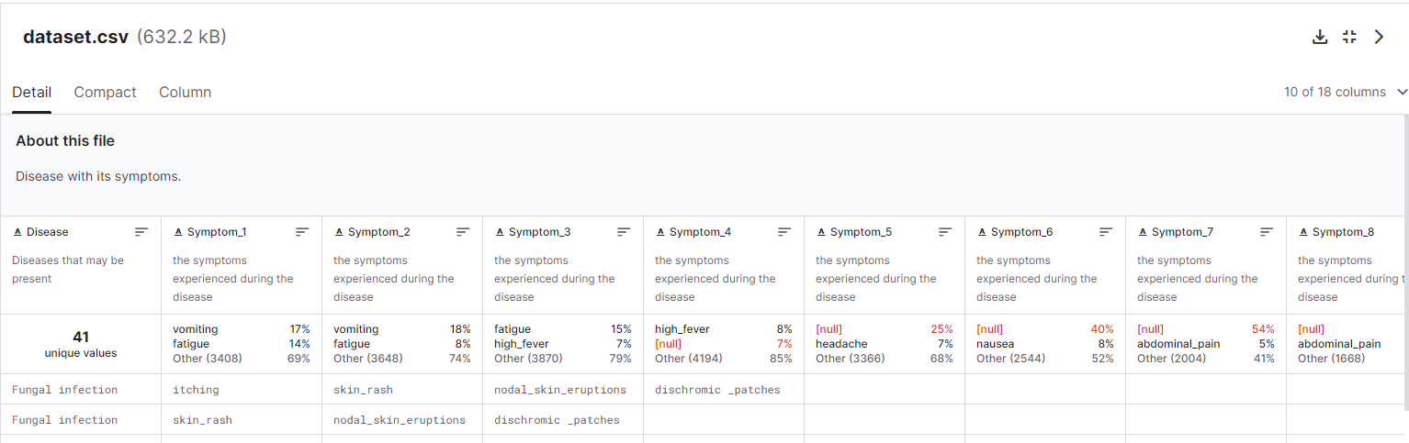
Dataset description
We used the below dataset from Kaggle.
There are columns containing diseases, their symptoms and their weights.
https://www.kaggle.com/datasets/itachi9604/disease-symptom-description-dataset/data?select=dataset.csv https://www.kaggle.com/datasets/itachi9604/disease-symptom-description-dataset/data?select=Symptom-severity.csv

Slide 4
Dataset description
We used two csv files for predicting the disease. One csv file contains the symptoms and the disease columns and the next csv file contains the weights of the respective symptom.
Disease csv file contains 18 features , in which 17 columns are the symptoms and the output is the disease of the respective symptoms
The weight csv file contains the weight of the respective symptoms which is used for filling NAN symptoms values during encoding

Slide 5
DATA-PREPROCESSING
After collecting that data, as that data is raw data we have to make it suitable for training our machine learning model. By using some python libraries like NumPy, and pandas, we have made that data suitable for machine learning models
The collected data are preprocessed for the availability of missing values in most of the structured data. Hence, it is essential to fill out the missed data or remove or modify them to enhance the quality of the data set. The preprocessing step also eliminates the commas, punctuations, and white spaces. Once the preprocessing of data has been completed, it is then subjected to feature extraction followed by disease prediction
The numerical features are scaled using StandardScaler and MinMaxScaler to ensure that they have the same scale and to improve the performance of the model.

Slide 6
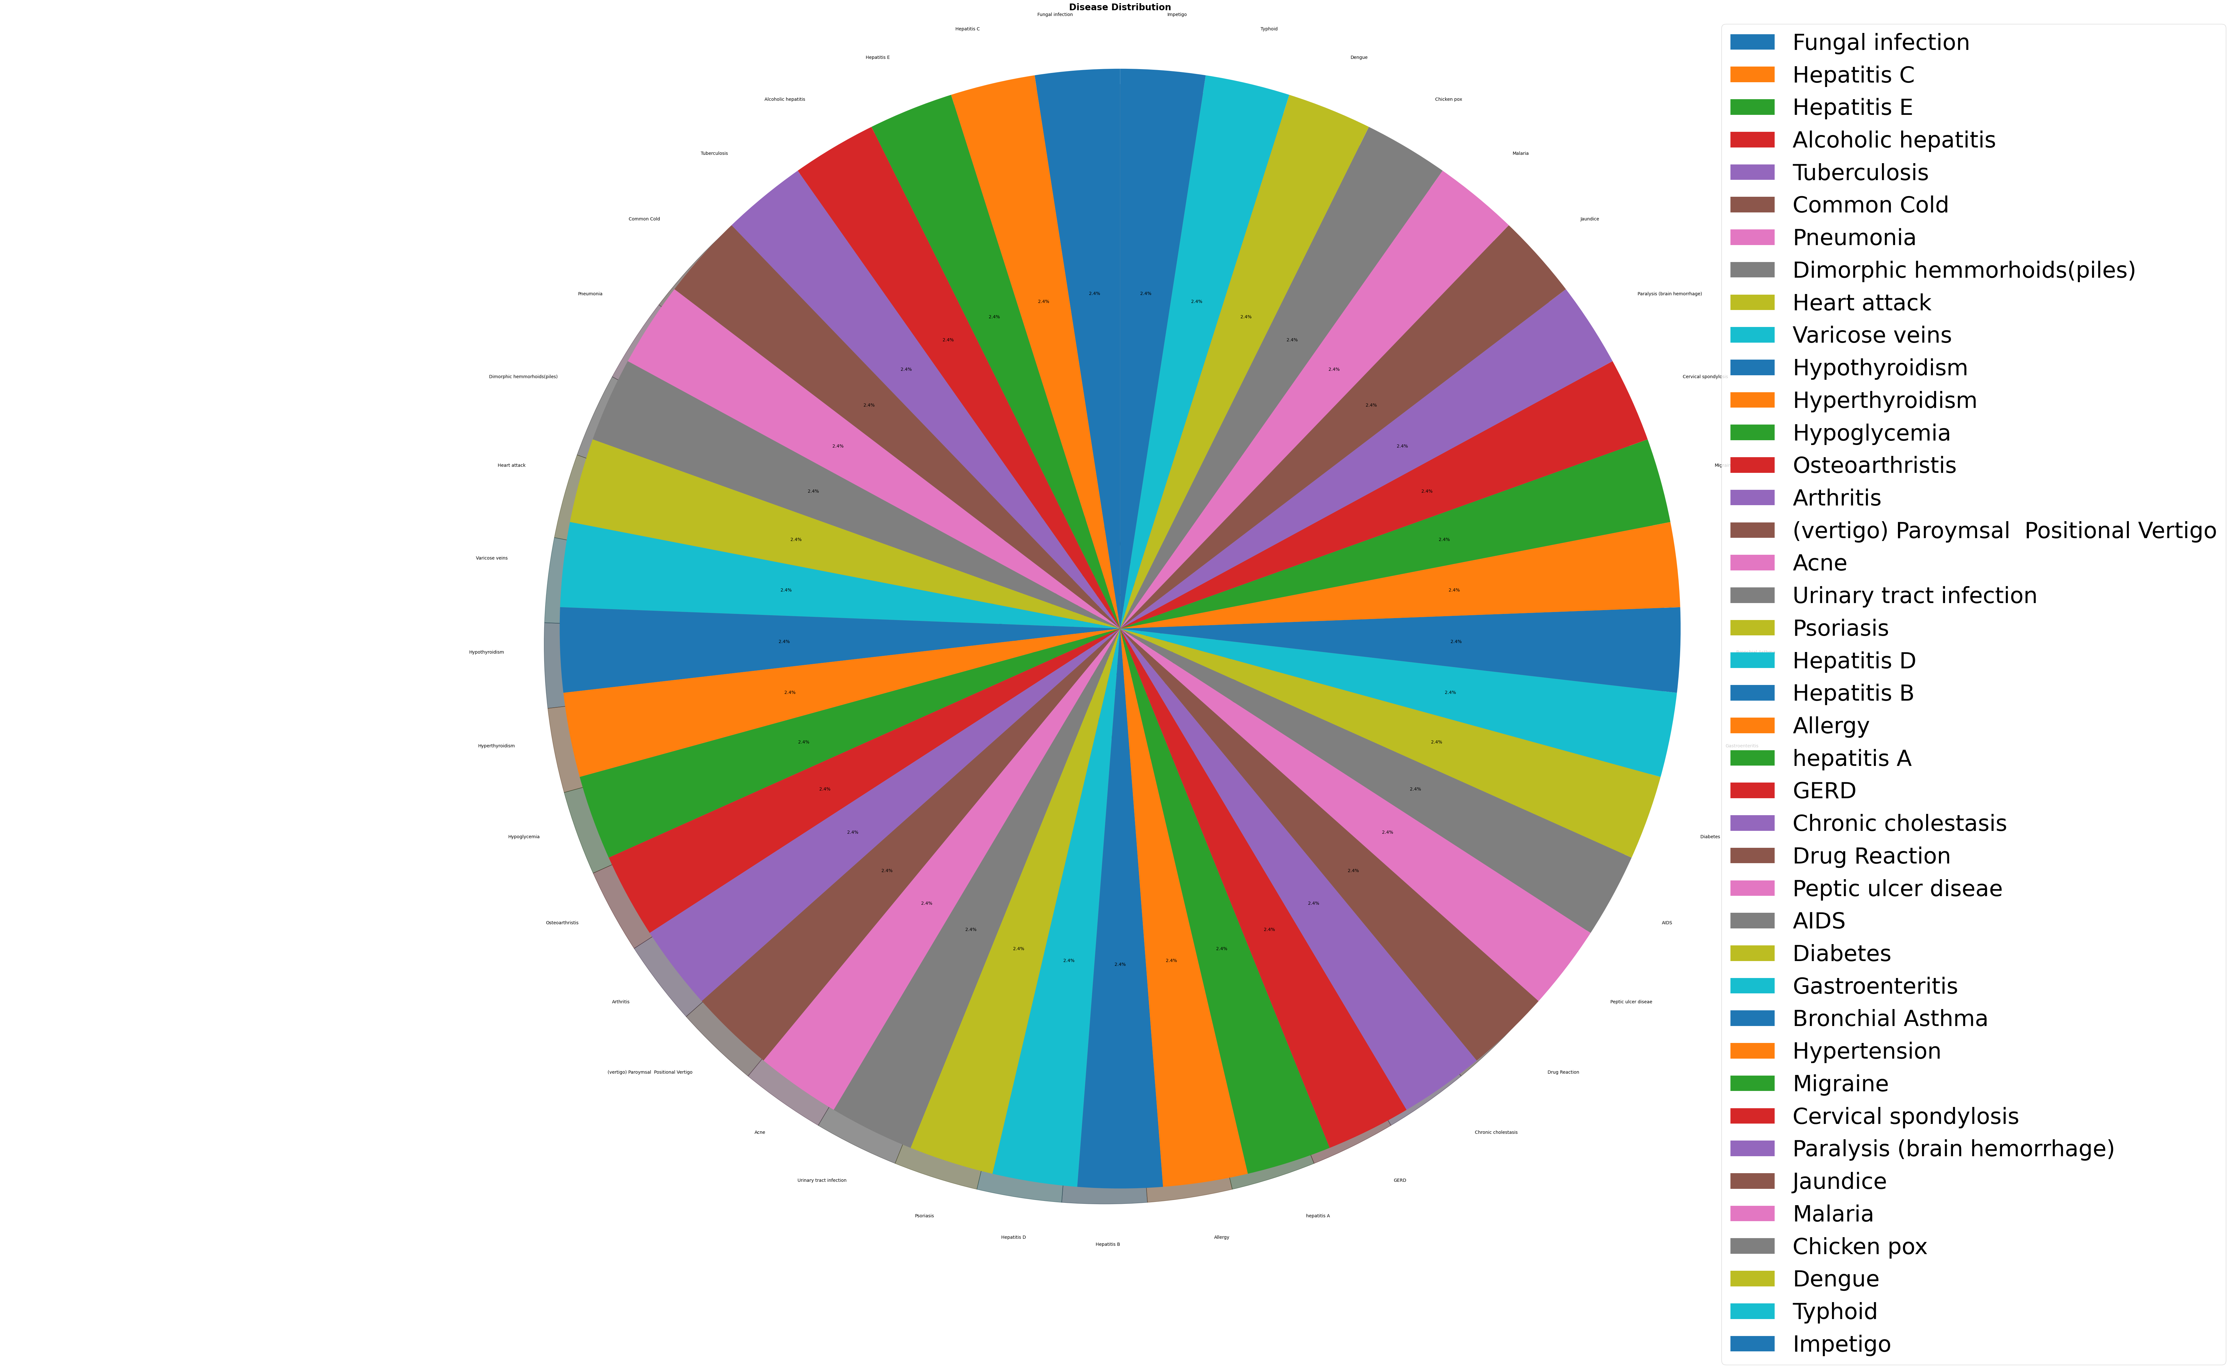
Visualization of Diseases

Slide 7
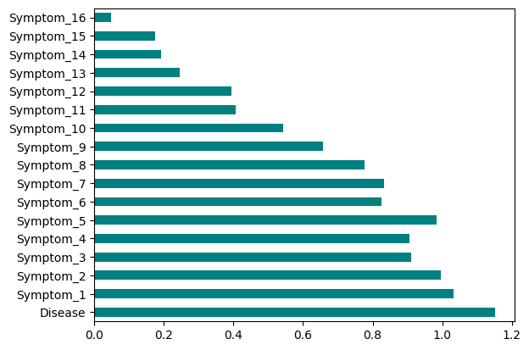
FEATURE SELECTION

Slide 8
Models used for analysis:
Regression models:
Linear Regression
Lasso and Ridge Regression
Logistic regression
Gradient Descent

Slide 9
Models used for analysis:
Classification models:
Decision tree
Random forest
Ensemble
KNN
Naive Bayes
SVM

Slide 10
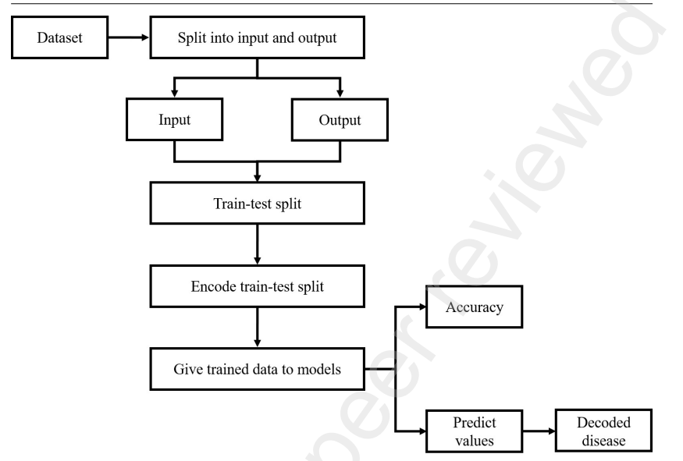
Functioning of the ML models. The dataset was split into input consisting of age, gender, and symptoms and the output as the diseases based on the input factors. We randomly split the available data into train and test sets. These sets were then encoded and further trained using different algorithms. After which the algorithms test the training set and predict the values, resulting in the accuracy of different ML algorithms. The predicted values were then decoded to give the output as the disease.

Slide 11
S.NO | MODEL | ACCURACY | F1 SCORE | PRECISION | RECALL
1. | LOGISTIC REGRESSION | 89.43% | 91.3 | 91 | 92
2. | KNN(K=4) | 99% | 99.2 | 99.3 | 99.18
3. | DECISION TREE | 99.18% | 99.09 | 99.37 | 99.17
4. | RANDOM FOREST | 99.58% | 99.14 | 99.28 | 99.09
5. | SVM-LINEAR | 93.3% | 93.35 | 94.24 | 93.39
6. | SVM-POLYNOMIAL (DEGREE=3) | 94.3% | 93.91 | 94.816 | 93.8
7. | SVM-RBF KERNAL (GAMMA=0.1) | 97.48% | 97.5 | 97.523 | 97.26
8. | SVM-RBF KERNAL (GAMMA=1) | 99.28% | 99.18 | 99.25 | 99.18
9. | NAIVE BAYES | 67.8% | 66.1 | 69.1 | 68.4

Slide 12
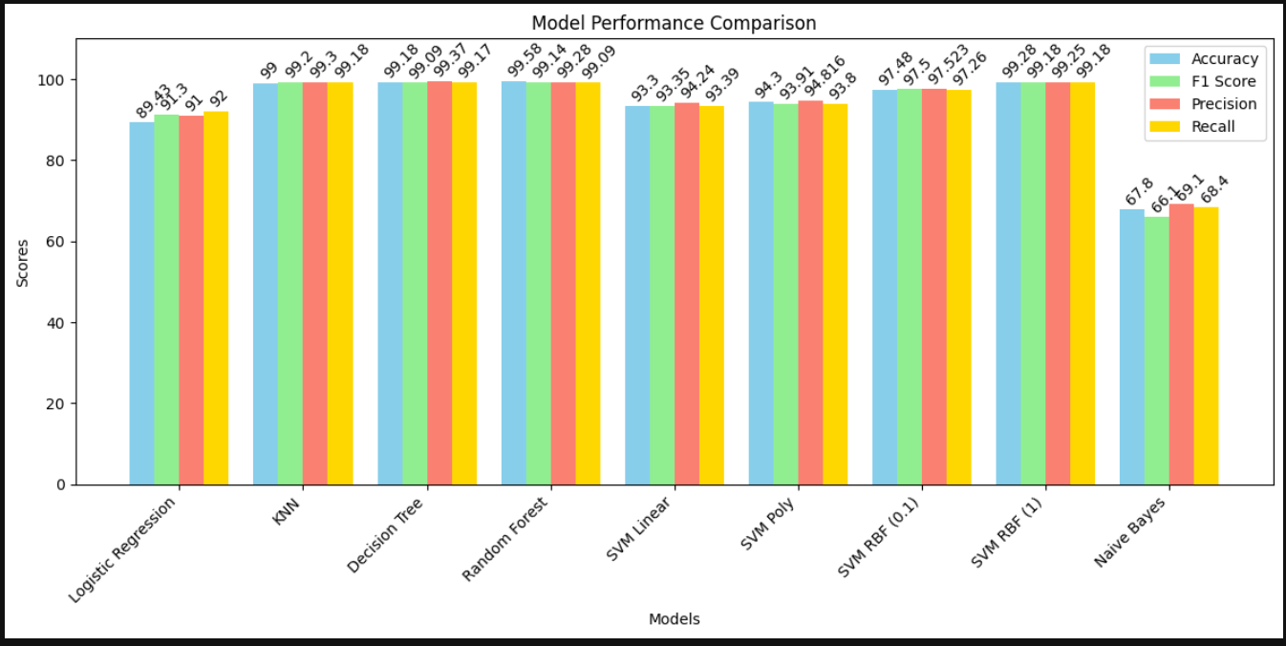
COMPARATIVE ANALYSIS

Slide 13
INFERENCE
Different machine learning models were used to examine the prediction of disease for available input dataset.
The table shows the comparative analysis of the accuracy of the training models. From the earlier necessities, Random Forest Algorithm was best with a model accuracy of 99.58%.
Following the Random Forest is the Decision Tree with an accuracy of 99.18%.
The SVM and KNN models were also very close.
However, the suggested model, that is Random forest model, yields the most accurate result, 99.5% as compared to earlier methods.
Among all the models, we gained the highest accuracy for the Random Forest model of 99.58 %.

Slide 14
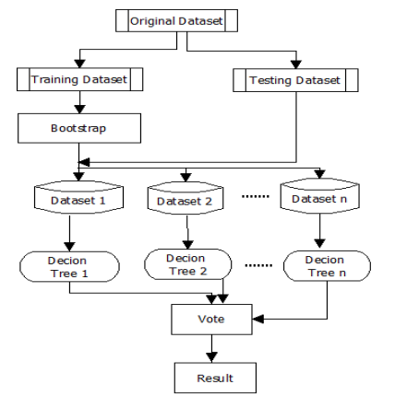
Advantage of Random Forest:
Different machine learning models were used to examine the prediction of disease for available input dataset.
While training the model, the decision forests that are formed while concluding are pruned as soon as they encounter a weak symptom or a symptom that does not occur in a location.
Thus, Random Forest Algorithm minimizes the cost whilst predicting a more realistic model.

Slide 15
Conclusion:
The problems faced by the medical industry with the unaffordability of the patients to seek dictators and the unavailability of the medical staff can be diminished.
This can happen via the use of a disease prediction system.
This system will input the patient’s symptoms and produce possible disease as an output with 99% accuracy as compare to earlier models.
The proposed model can assist the healthcare industry by: 1. Reduction in healthcare costs:
2. Improved patient outcomes:
3. Early diagnosis:
The model can be used for providing an enhanced, more accurate framework that would lead to a better human disease prediction model.

Slide 16
References:
[1] K. Gaurav, A. Kumar, P. Singh, A. Kumari, M. Kasar, T. Suryawanshi, Human Disease Prediction using Machine Learning Techniques and Real-Life Parameters, International Journal of Engineering, Transactions C: Aspects, Vol. 36, No. 06, (2023), 1092-1098
[2] https://www.geeksforgeeks.org/disease-prediction-using-machine-learning/
[3] https://www.kaggle.com/code/kunal2350/disease-prediction-and-analytics
[4] Divya, A., Deepika, B., Durga Akhila, C.H. et al. Disease Prediction Based
onSymptoms Given by User Using Machine Learning. SN COMPUT. SCI. 3, 504 (2022).
https://doi.org/10.1007/s42979-022-01399-0

Slide 17
Thank you!
KRISHNA MURTHY - CB.EN.U4CSE21016
S MEENAKSHI - CB.EN.U4CSE21035
LIKITHA PICHERI - CB.EN.U4CSE21044
RAGALA TEJDEEP - CB.EN.U4CSE21046

